Slide 1
Debian
& the
BeagleBone Black
Raju D. Vindane
Notes:
Ask people about the concept of IoT?
Tell them about IoT in a nutshell.
How IoT will be implemented?

Slide 2
Lets meet a Small Computer.

Slide 3

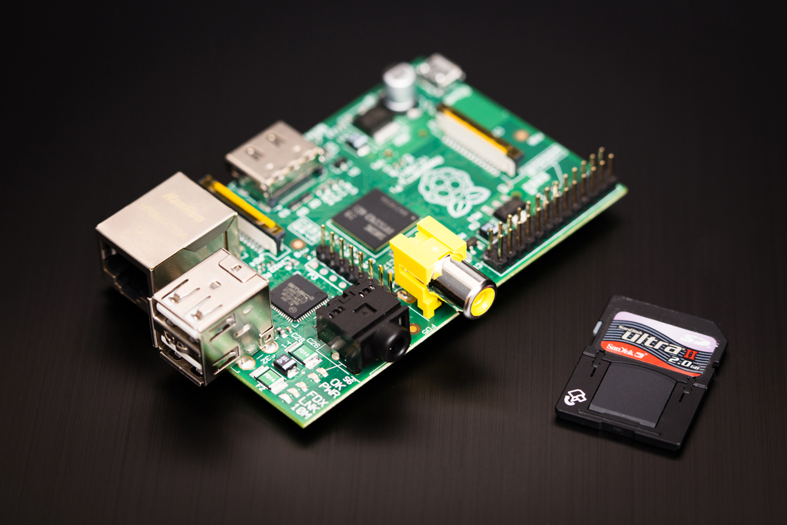
You might be familiar with these
Arduino
Raspberry Pi
Notes:
Open Source Hardware
Telling them some more about the arduino & Rpi

Slide 4
Computer
Micro controller
USB Programmer

Slide 5
Arduino
Computer

Slide 6
Single Board Computers
Rpi, BBB, Radxa Rock etc.

Slide 7
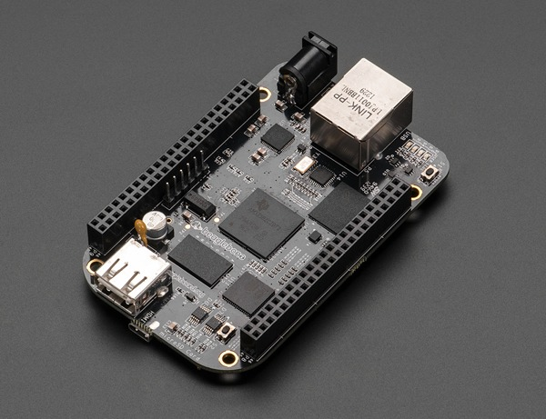
So what is a BeagleBone Black?
Notes:
-It is a SBC.
- The Input & Output Devices thing
-

Slide 8
Fast
  1 GHz ARM Cortex A8
  Two 200 MHz microcontrollers (super cool!)
Lots of memory
  512 MB DRAM
  4 GB Flash and MicroSD card slot
Connects to everything
  Ethernet, USB, HDMI
  Tons of I/Os via the 2 46 pin headers

Slide 9
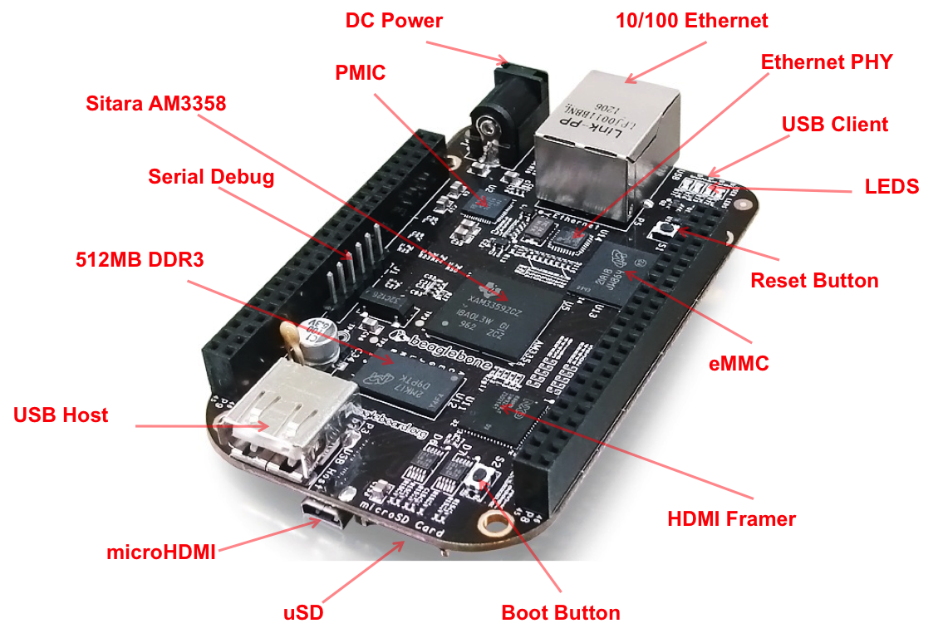
Notes:
-Specifications

Slide 10






What Operating Systems Can I run on A BeagleBone Black?

Slide 11
Very, Extremely, Outrageously
POWERFUL
● Can run Debian, Ubuntu, Fedora, Android etc.
● Can support multitasking, multithreading etc.
● A small, portable full fledged computer.

Slide 12
Getting started with the BeagleBone Black?

Slide 13
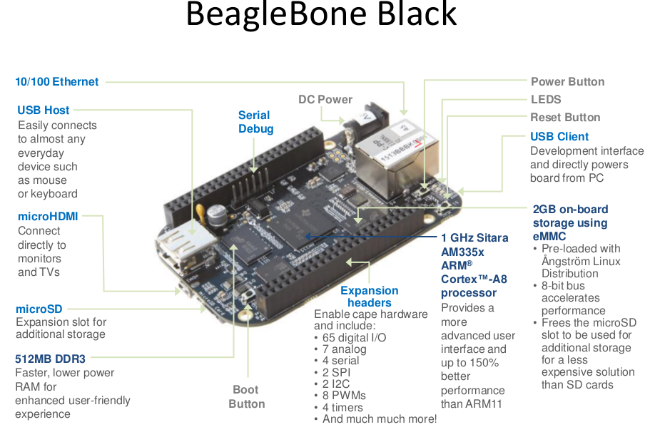

Slide 14
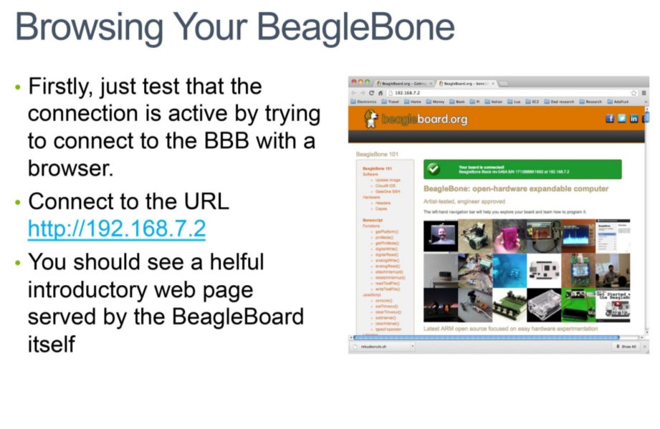

Slide 15
Programming on the BBB
Program with anything, Its a Computer people.
CLoud9 IDE

Slide 16
What is so special about Debian on the BeagleBone Black?
It is running Debian & not some BeagleBone Blackbian.
kernel version used on the bbb is very bleeding edge.

Slide 17
Robert Nelson
rcn-ee.net/deb/wheezy-armhf

Slide 18


BeagleBone Black vs RaspBerry Pi
OSHW
Clones exist
Costs the same as RPi+Power adapter+SD card ADC, hardware PWM, tonnes more pins, more serial ports, CAN, onboard eMMC, etc.
! OSHW
Can't buy in single quantities
Needs a lot of setup to get started with
Less no. of GPIOs

Slide 19
BBB vs RPi
It is the same with Debian vs Ubuntu

Slide 20
Who is using the BeagleBone Black?
Lets see some videos

Slide 21
Where Can I get a Beaglebone Black
Fizzible.com
Ebay.in
Amazon.in

Slide 22
Whats in store Next?

Slide 23
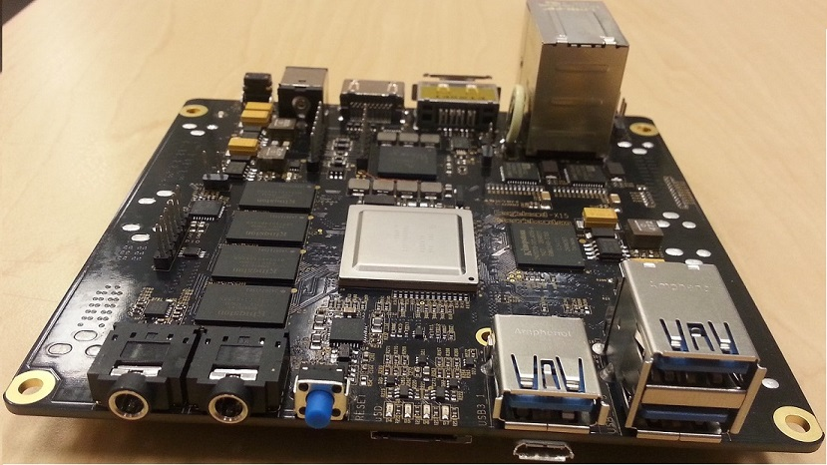
X15
Processor – TI Sitara AM572 (2x Cortex-A15 cores @ 1.5GHz)
Memory/storage:
2GB DDR3L (via dual, 32-bit buses)
4GB eMMC flash
MicroSD slot
eSATA port
Display/imaging:
HDMI port at up to 1920 x 1080 @ 60fps
LCD interface
Video-in port
Networking — 2x gigabit Ethernet ports
Other I/O — 3x USB 3.0 ports; audio I/O

Slide 24
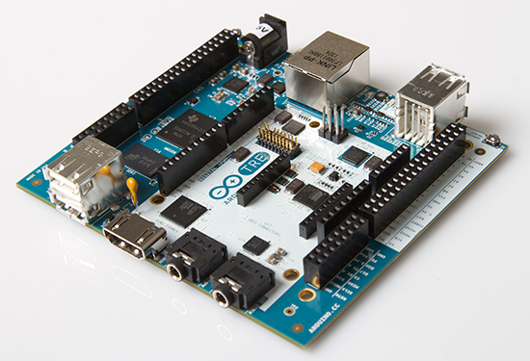
Arduino TRE
Technical Specifications (preliminary)
Microcontroller Atmel ATmega32u4
Clock Speed 16 MHz
Flash Memory 32 KB (ATmega32u4)
SRAM 2.5 KB (ATmega32u4)
EEPROM 1 KB (ATmega32u4)
Digital I/O Pins (5V logic) 14
PWM Channels (5V logic) 7
Analog Input Channels 6 (plus 6 multiplexed on 6 digital pins)
Processor Texas Instrument Sitara AM3359AZCZ100 (ARM Cortex-A8)
Clock Speed 1 GHz
SRAM DDR3L 512 MB RAM
Networking Ethernet 10/100
USB port 1 USB 2.0 device port, 4 USB 2.0 host ports
Video HDMI (1920x1080)
Audio HDMI, stereo analog audio input and output
Digital I/O Pins (3.3V logic) 23
PWM Channels (3.3V logic) 4
MicroSD card
Support LCD expansion connector

Slide 25
Demo's

Slide 26
GUI

Slide 27
External LED Blinking

Slide 28
Bacon Cape

Slide 29
Arduino TRE

Slide 30
Learning Resoursces
beagleboard.org
elinux.org

Slide 31
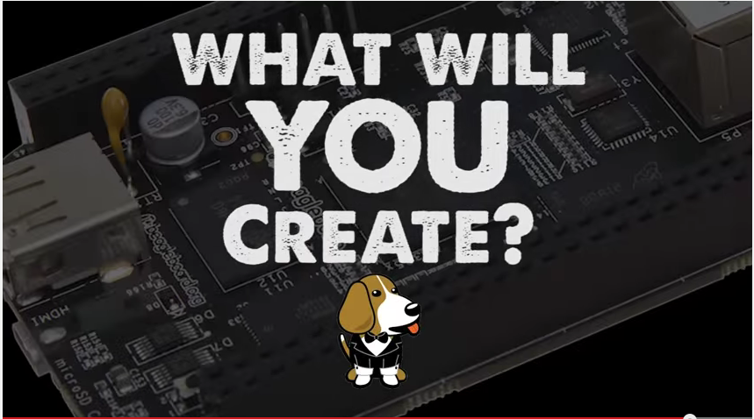

Slide 32
I can be contacted on
THANK YOU
rajudv on Diaspora
On twitter as @rajuvindane
facebook.com/rajudv
rajuvindane@cryptolab.net

